Slide 1

MET CS 777 Term Project: Analyzing Financial Data Using Gradient Descent and K-Means Clustering
By: Noor-Aldean Deek

Slide 2

Project Overview
Explore how financial metrics impact a company's market value over time
categorize companies based on similarities in their financial metrics
This is achieved using two powerful machine learning techniques: Gradient Descent and K-means Clustering.

Slide 3

Data Collection & Dataset Description
dataset sourced from WRDS (Wharton Research Data Services) and covered 25 years of financial data for thousands of companies
Data included: Total Assets, Long Term Debt, Liabilities, Net Income, Revenue, Shares Outstanding
Found some larger data to be inaccurate (such as market cap for stocks), so used shares outstanding * quarter closing stock price to manually generate that information, cross-referencing it with accurate online data

Slide 4
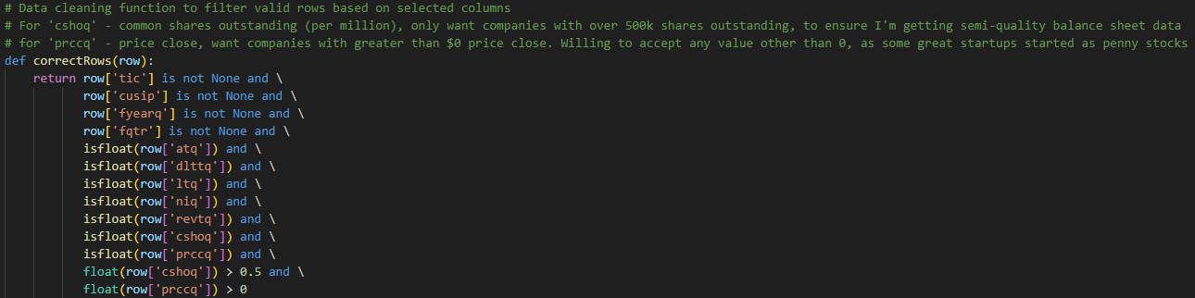
Data Cleaning & Preprocessing
The initial dataset contained 1,134,506 rows, ultimately reduced the dataset to 695,749 rows

Slide 5

Gradient Descent Results
Final Weights:
Assets (atq): 7,785.36
Long-term Debt (dlttq): -1,563.29
Liabilities (ltq): -2,489.41
Net Income (niq): 10,819.21
Revenue (revtq): 8,902.73
Price Close (prccq): 3,947.22
Price High (prchq): 3,214.87
Price Low (prclq): 2,876.39
Final Intercept: 8,784.79
Final Cost (Loss): 482,895,005.62
Final Learning Rate: 0.887

Slide 6
K-Means Clustering Results
Total Assets (atq), Long-term Debt (dlttq), Liabilities (ltq), Net Income (niq), Revenue (revtq), Price Close (prccq), Price High (prchq), Price Low (prclq)
array([0.01433253, 0.00405741, 0.00425073, 0.04690792, 0.08647996, 0.02145579, 0.0214851 , 0.02047041])
Cluster 1: Represented smaller companies with lower assets, liabilities, revenue, and market value.
array([10.48393291, 3.38990897, 9.57795132, 8.10865134, 10.179201 0.19319167, 0.19129109, 0.18923176])
Cluster 2: Included mid-sized companies with moderate financials.
array([ 4.50108426e+01, 7.38600287e+01, 4.80462226e+01, 4.85666572e+00, 6.07615103e+00, -3.59091033e-02, -3.68708661e-02, -3.42315930e-02])
Cluster 3: Comprised large, financially stronger companies with substantial assets, revenue, and market value.

Slide 7
Conclusion & Future Work
Model Refinement: further refined by exploring different feature sets
Expanded Clustering: The K-means clustering could be expanded by including additional financial or non-financial variables (e.g., industry sector, geographical location) to capture a broader range of company characteristics.
Predictive Analysis: The current analysis focused on historical data. Future projects could use these models to predict future market value or financial trends, applying time-series forecasting techniques (provided a more accurate in-depth dataset).

